Slide 1
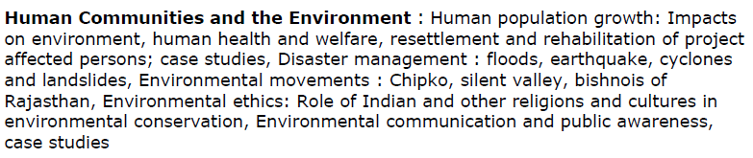
Unit 6
Human Communities and the Environment
Social issues and Environment-II
Population Explosion and Family welfare Program
Environment and Human Health
Environmental ethics
Diaster managemnt
Environmental movements
Role of an individual to protect environment

Slide 2
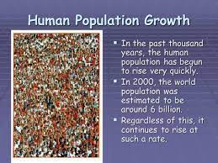

Slide 3
Population Growth
The increase in the number of individuals in a population is known as population growth.
Demography
The study of human population trends is called demography.

Slide 4
Factors Deciding the Growth or Decline of Population
Birth Rate-Number of births per thousand people in a geographical area.
Death rate-Number of deaths per thousand people in a geographical area.
Migration -Rate of change in population for a specific area.

Slide 5
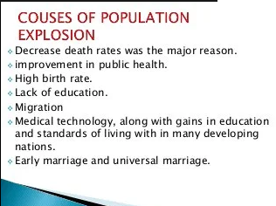
Causes of Population Growth
Availability of cure for many life-threatening diseases
Poverty
Preference for sons
Custom of early marriages
Improvement in public health
Illiteracy

Slide 6
Effects of Population Growth
Excessive exploitation of natural resources
Unemployment
Lack of proper health and sanitation facilities
Environmental pollution

Slide 7
Resettlement and Rehabilitation
Reasons for Displacement of Human Habitation
Natural hazards – Earthquakes, cyclones, landslides, floods, drought,
volcanic eruptions, and epidemic diseases
Anthropogenic factors – Developmental activities such as construction of dams, roads, tunnels, etc., which increase the risks of calamities such as floods and landslides. Other factors include accumulation of wastes and environmental pollution

Slide 8
Problems Faced by Displaced People
The compensation for the lost land is often not paid or the payment is delayed.
Basic infrastructure and amenities are not provided in the new area.
Very often, temporary camps become permanent settlements.
Ethnic and caste differences make it difficult for the refugees to live peacefully with the communities already living in the area.

Slide 9
Resettlement and Rehabilitation
Reasons for Displacement of Human Habitation
Natural hazards – Earthquakes, cyclones, landslides, floods, drought,
volcanic eruptions, and epidemic diseases
Anthropogenic factors – Developmental activities such as construction of dams, roads, tunnels, etc., which increase the risks of calamities such as floods and landslides. Other factors include accumulation of wastes and environmental pollution

Slide 10
Problems Faced by Displaced People
The compensation for the lost land is often not paid or the payment is delayed.
Basic infrastructure and amenities are not provided in the new area.
Very often, temporary camps become permanent settlements.
Ethnic and caste differences make it difficult for the refugees to live peacefully with the communities already living in the area.

Slide 11
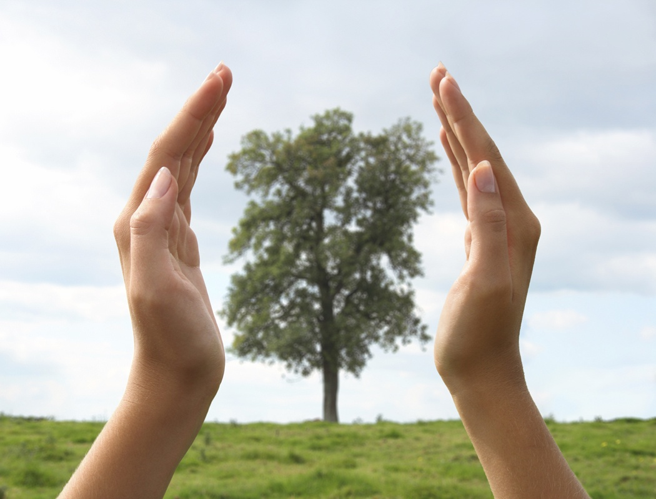
Environmental Ethics
Creating a moral sense of environmental conservation in each person
is called environmental ethics.

Slide 12
Environmental ethics:Issues. The Contrasting Views
Utilitarian justification (also known as individualistic ethics)
Ecological justification (also known as moral justification)
Environmental Equity and Priority Principle
Always respect all nature especially in cases where strong human rights are at stake
Environmental ethics: Possible Solutions
One should respect the power of environment and apply it for the benefits of humankind.
One should place the highest priority on health, safety, and environmental protection while using environmental products.
One should be sensitive to ethical and social issues regarding the environment.

Slide 13
Methods to generate public awareness
The methods to generate environmental awareness generally falls in two categories :
Formal Method
Introduction of Environmental Studies as a course in schools and colleges
Non Formal Method
Mass media such as newspapers, magazine, radio, T.V., etc
Organizing meetings, seminars and conferences
Organizing various competitions
Through folk songs, street plays, TV serials, etc.

Slide 14
1. population growth
https://www.youtube.com/watch?v=fTznEIZRkLg
2. resettlement and rehabilitation
https://www.youtube.com/watch?v=AJlbdAgoxec
3. Global growth vs human health: finding the balance
https://www.youtube.com/watch?v=ul4alU7P4tU

Slide 15
Video Links
Disaster management
https://www.youtube.com/watch?v=Kt-C8WCIWrg
Earthquake
https://www.youtube.com/watch?v=8HKx8b_yc50
Cyclone
https://www.youtube.com/watch?v=-AAG4HEsgMQ
https://www.youtube.com/watch?v=x6SQbSmvzQM
Landslides
http://video.nationalgeographic.com/video/101-videos/landslides

Slide 16
Animals from colder climates generally have shorter limbs. This is called (a) Allen’s rule (b) Johnson’s rule (c) Arber’s rule (d) Niche rule
Niche is defined as (a) a component of an ecosystem (b) an ecologically adapted zone of a species (c) the physical position and functional role of a species within the community (d) all plants and animals living at the bottom of a water body.
It natality is balanced by mortality in a population at a given time, there will be a/an (a) decrease in the population size (b) increase in the population size (c) zero population growth (d) population explosion

Slide 17
Animals from colder climates generally have shorter limbs. This is called (a) Allen’s rule (b) Johnson’s rule (c) Arber’s rule (d) Niche rule
Niche is defined as (a) a component of an ecosystem (b) an ecologically adapted zone of a species (c) the physical position and functional role of a species within the community (d) all plants and animals living at the bottom of a water body.
It natality is balanced by mortality in a population at a given time, there will be a/an (a) decrease in the population size (b) increase in the population size (c) zero population growth (d) population explosion

Slide 18
4. Mycorrhiza is an example of (a) ectoparasitism (b) mutualism (c) endoparasitism (d) predation
5. The interspecific interaction in which one partner is benefitted and the other is unaffected (neutral), is called (a) amensalism (b) mutualism (c) competition (d) commensalism
6. Individuals of one kind, i.e., one species occupying a particular geographic area, at a given time form a/an (a) community (b) biome (c) population (d) deme

Slide 19
4. Mycorrhiza is an example of (a) ectoparasitism (b) mutualism (c) endoparasitism (d) predation
5. The interspecific interaction in which one partner is benefitted and the other is unaffected (neutral), is called (a) amensalism (b) mutualism (c) competition (d) commensalism
6. Individuals of one kind, i.e., one species occupying a particular geographic area, at a given time form a/an (a) community (b) biome (c) population (d) deme

Slide 20
8. Niche overlap indicates (a) mutualism between two species (b) active cooperation between two species (c) sharing of one or more resources between the two species (d) two different parasites on the same host.
9. Amensalism is an association between two species where (a) one species is harmed and other is benefitted (b) one species is harmed and other is unaffected (c) one species is benefitted and other is unaffected (d) both the species are harmed.
10. A population has more young individuals compared to the older individuals. What would be the status of the population after some years? (a) It will decline (b) It will stabilise (c) It will increase (d) It will first decline and then stabilise

Slide 21
8. Niche overlap indicates (a) mutualism between two species (b) active cooperation between two species (c) sharing of one or more resources between the two species (d) two different parasites on the same host.
9. Amensalism is an association between two species where (a) one species is harmed and other is benefitted (b) one species is harmed and other is unaffected (c) one species is benefitted and other is unaffected (d) both the species are harmed.
10. A population has more young individuals compared to the older individuals. What would be the status of the population after some years? (a) It will decline (b) It will stabilise (c) It will increase (d) It will first decline and then stabilise

Slide 22
11. Which of the following would necessarily decrease the density of a population in a given habitat? (a) Natality > mortality (b) Immigration > emigration (c) Mortality and emigration (d) Natality and immigration
12. What parameters are used for tiger census in our country’s national parks and sanctuaries? (a) Pug marks only (b) Pug marks and faecal pellets (c) Faecal pellets only (d) Actual head counts

Slide 23
11. Which of the following would necessarily decrease the density of a population in a given habitat? (a) Natality > mortality (b) Immigration > emigration (c) Mortality and emigration (d) Natality and immigration
12. What parameters are used for tiger census in our country’s national parks and sanctuaries? (a) Pug marks only (b) Pug marks and faecal pellets (c) Faecal pellets only (d) Actual head counts

Slide 24
Thank You

